Slide 1
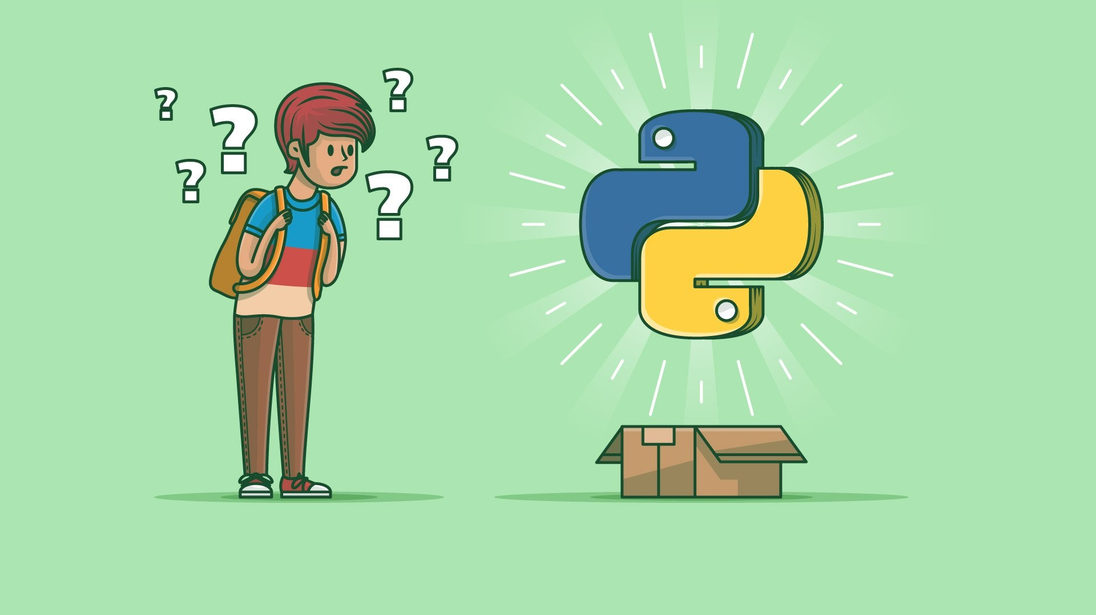
What is Python,
What you can do with it
Why it is so popular?

Slide 2
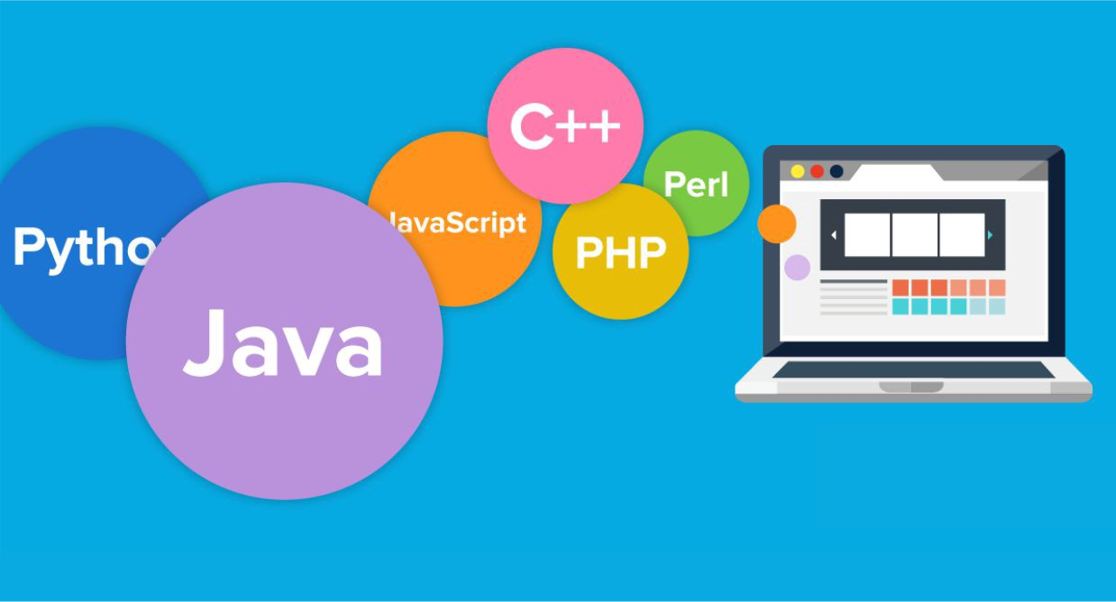
What is Python?
Python is world’s fastest growing programming language,
not just amongst software engineers but also:
Students
Data Analysts
Project managers
Engineers
Accountants
Simply Everyone!

Slide 3
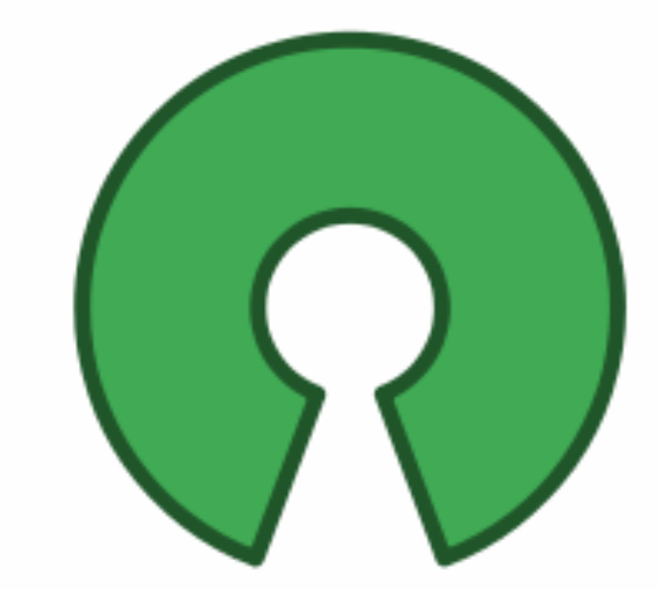
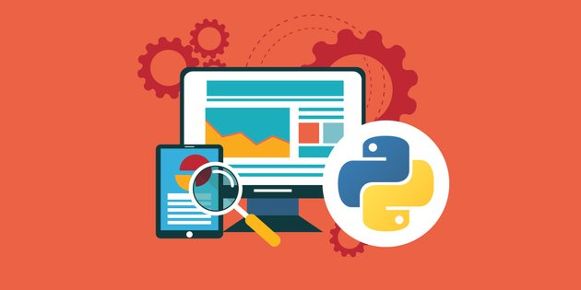
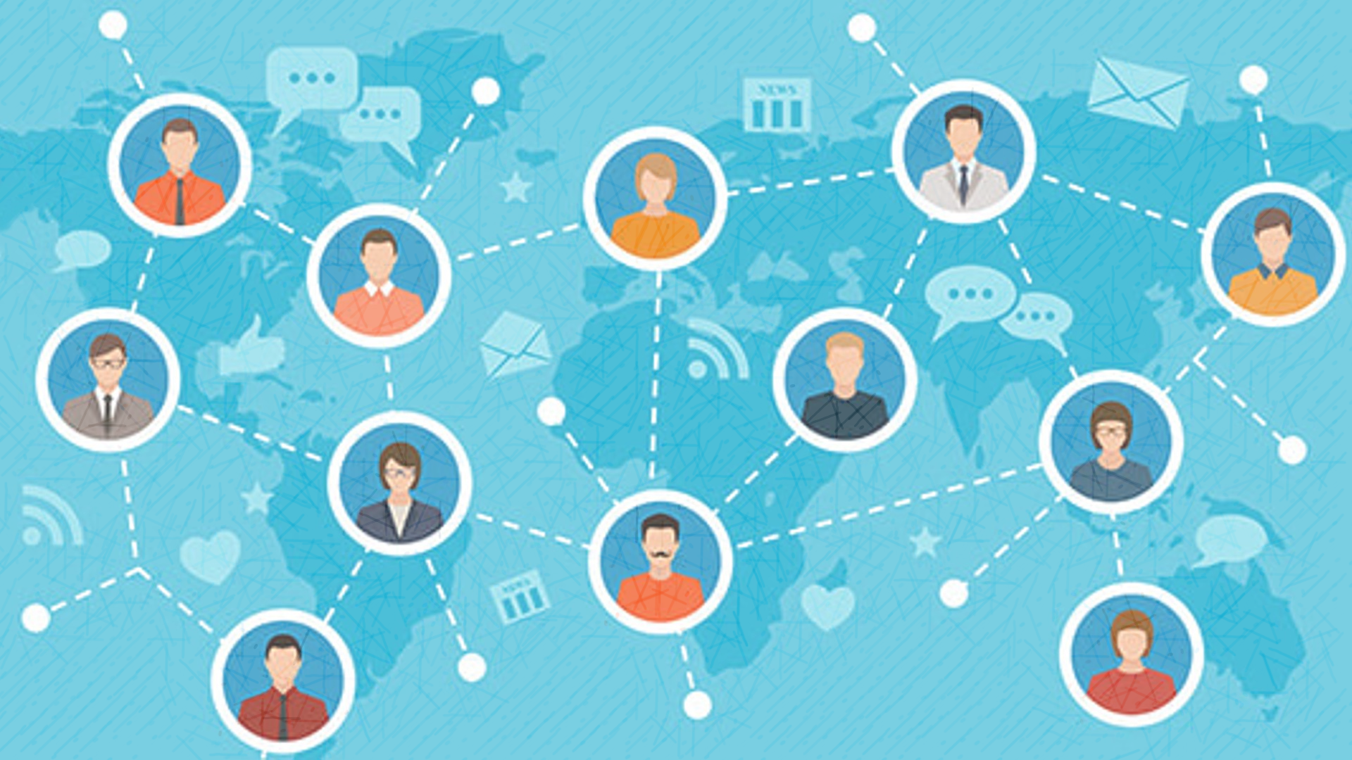
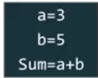
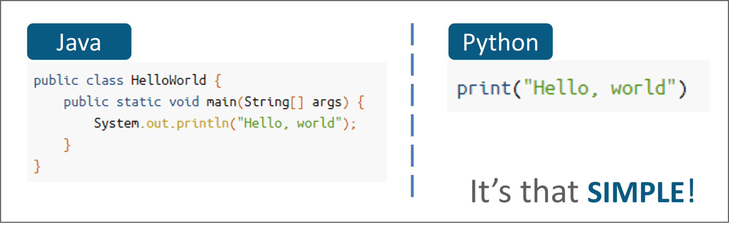
Why is Python popular?
Free & open source
Multi-purpose
Large Community
Simple and beginner friendly

Slide 4

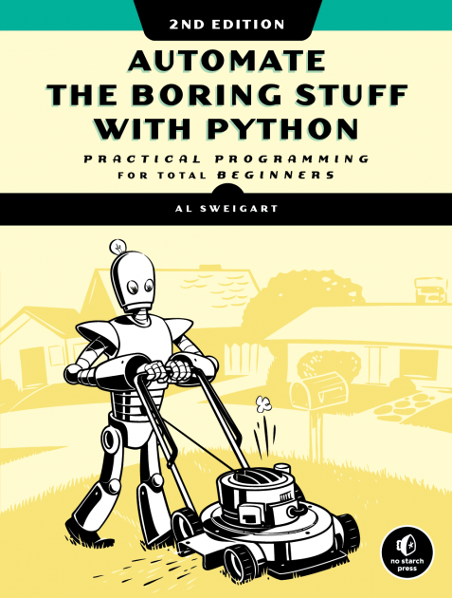
What you can do with python?
Automation
You can use Python to write programs that do in minutes what would take you hours to do by hand-no prior programming experience required, here are some examples:
Create, update, move, and rename files and folders
Update and format data in Excel spreadsheets of any size
Running scripts and commands in deferent machines
Search for text in a file or across multiple files
Split, merge, watermark, and encrypt PDFs
Send reminder emails and text notifications
Fill out online forms
Create a Calculator
Great Reference

Slide 5
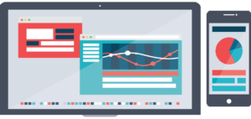
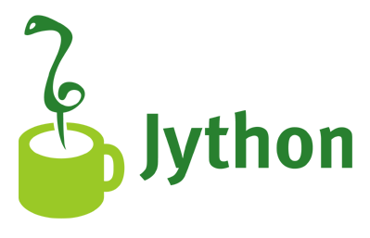



What you can do with python?
Computer Graphics
Graphical User interface
Desktop Applications
Game Development

Slide 6
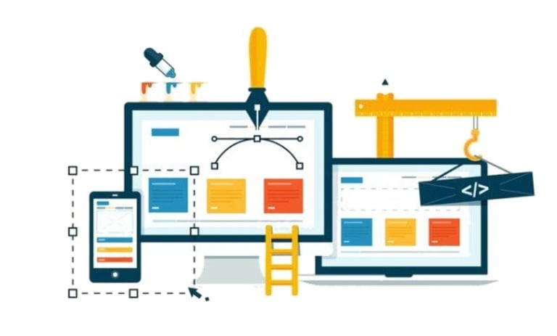




What you can do with python?
Web Development
Develop Web applications
Scrape Websites

Slide 7
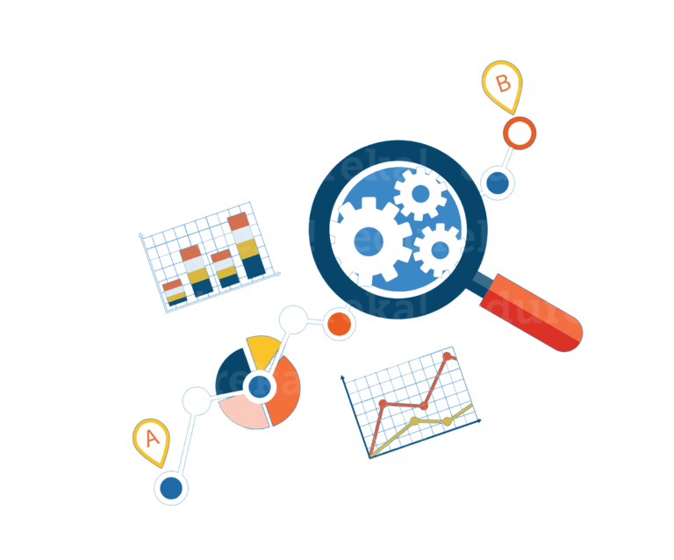

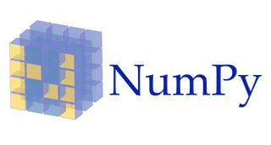
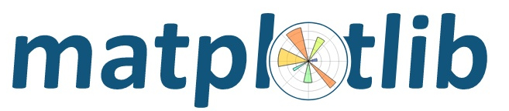

What you can do with python?
Data Science
Well suited for data manipulation and analysis
Deals with tabular data and spreadsheets
Arbitrary matrix data
Observational and statistical datasets
Data visualization libraries

Slide 8
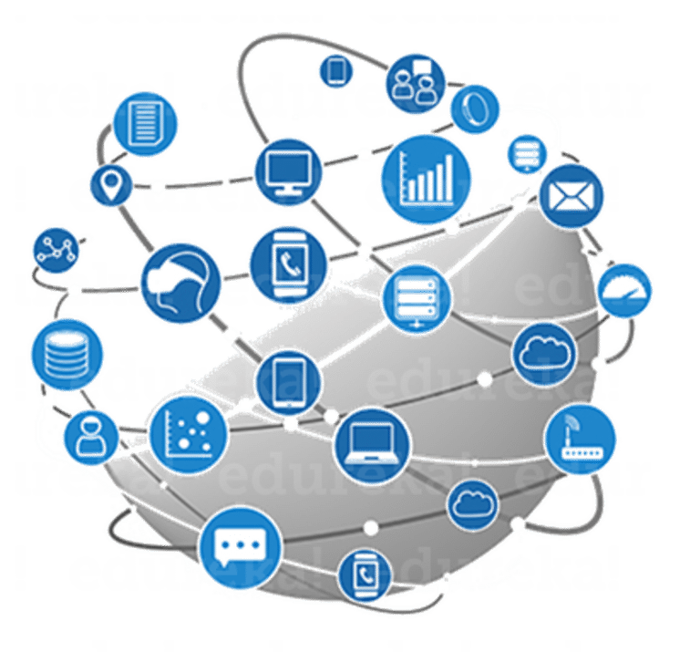
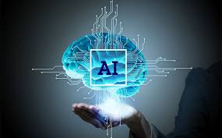
What you can do with python?
Automation
Applications and Gaming
Web Deployment
Data Science
Big Data
AI and Machine learning

Slide 9


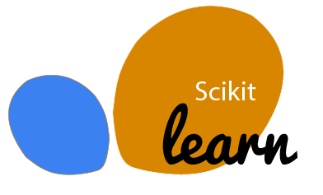
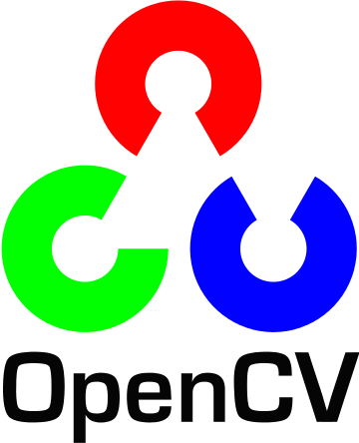

What you can do with python?
Artificial Intelligence & Machine Learning

Slide 10
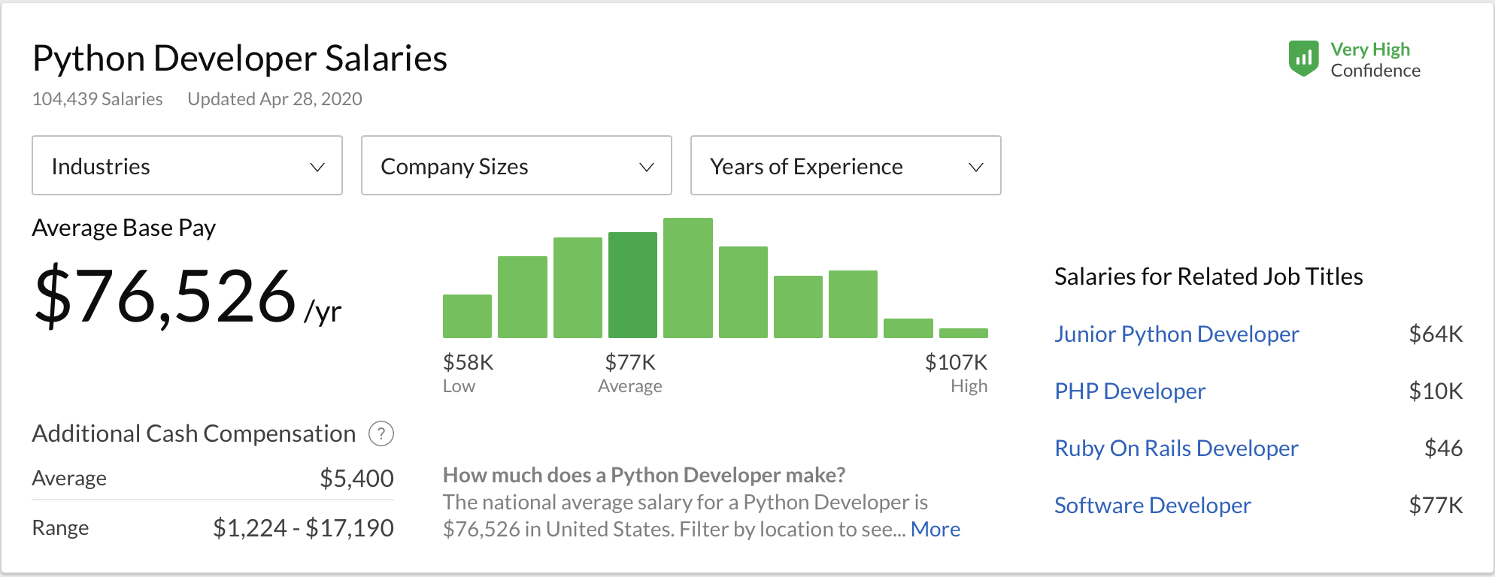
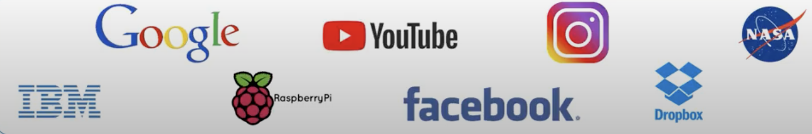
Popularity and High Salary

